Slide 1
Benha University Mobile Application 2016-2017
Project Mentor: Project Mentor:
Dr. Ahmed Bayoumi Dr. Shady Yahia
Team Members:
Ahmed Nabil Hosny Abd EL-Motaleb
Bassma Ali El-Den Yahia Ali
Kareem Mohammed Tawfeek Mohammed
Mahmoud Mohammed Taha
Manal Hesham Hassan Korany

Slide 2
Introduction
A University APPs which can provide huge amount of data and benefits and help students to save a lot of time
Online University APPs are much like hard copy material , news papers and have the same legal boundaries such as laws regarding privacy and copyright.
Benha App has many new modules old & new ones to maximize students and staff member benefits

Slide 3

MAL (mobile application Launchpad)
. Tech & Innovation Track
Applicants can apply on their own or as part of a team consisting of at most 2 members
Every team must have completed the Google-Sponsored Udacity Course
Apps must be newly created and innovative, solving a social problem

Slide 4
Project Objective
To develop an Interactive Android App which provides
News in different languages like English, Arabic to provide Latest updates about university.
Access different educational mails like : EBK and university mails
Indoor navigation → to get your directions in the university using your APP
Outdoor navigation → get directions to any Benha University departments & colleges

Slide 5
Project Objective
Allow students to fill questionnaire from APP
Provide Emergency Info and safety rules about University
Attendance recorder – easy to identify students with QR code or RFID
Provide data about courses and staff and Notify students about new contents from their staff
Propagate University Mission and Vision between students

Slide 6
What we learnt?
Android Programming
Indoor Localization & mapping
Android Web-viewer.
OCR & QR codes development
AI search technics like A* search
Database and server integrations in big systems

Slide 7
modules
Notifications
Exam results
Portal
EKB
Office365
Library
Staff
Navigation
Start page
Mission & Vision
Attendance
Time table
News
Courses
Maps

Slide 8
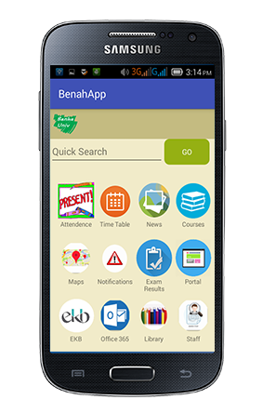
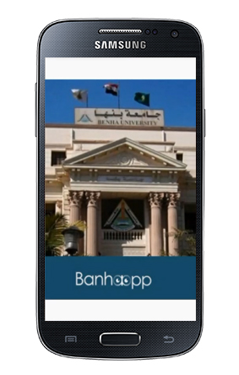
Splash screen

Slide 9
Custom list
Every view which gets inflated from an XML layout file will result in a Java object. Inflating layouts and creating Java objects are expensive with regards to time and memory consumption.
In addition using the findViewById() method is relatively time consuming, even though it is not as bad as XML inflating.
So we used custom list to enhance performance

Slide 10
Indoor Navigation
Each college has a lot of classes , rooms and floors this can cause long time to get To your destination class
Using our App will help to provide data, route and instruction to reach any location in your local college without using internet or GPS

Slide 11
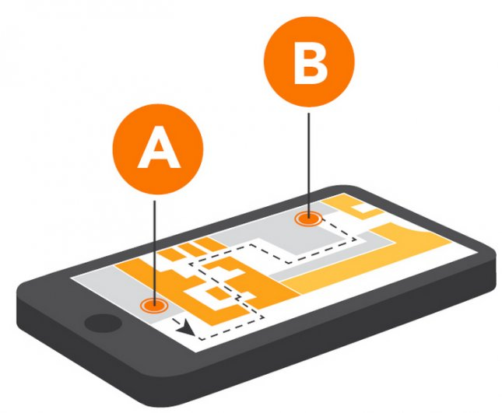
Indoor Navigation
An indoor positioning system (IPS) is a system to locate objects or people inside a building using radio waves, magnetic fields, acoustic signals, or other sensory information collected by mobile devices.
There are several commercial systems on the market, but there is no standard for an IPS system

Slide 12
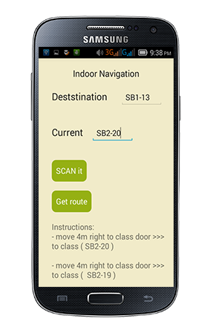
The start Activity of Indoor Navigation

Slide 13
Why not to use GPS …?
Global navigation satellite systems (GPS or GNSS) are generally not suitable to establish indoor locations
Microwaves will be attenuated and scattered by roofs, walls and other objects.

Slide 14
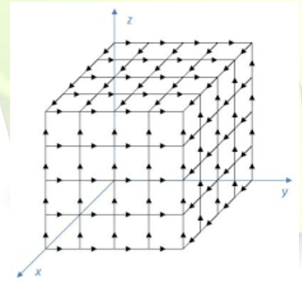
Smart building model
This idea that we can represent any college programmatically as a graph of nodes
Each node is one of the classes
The cost between nodes indicates the distance , upstairs and downstairs between the classes
Euclidean heuristic function

Slide 15
Techniques used in indoor navigation
A-star search technique
As a good way to fine the best route between the source and the destination is to use the A-star search technique
Optical Character Recognition
Some new student are not aware with the addressing system of the classes so we help them by OCR system
So they need only to use this system to take a photo to name plate of their current location and our system will lead them

Slide 16
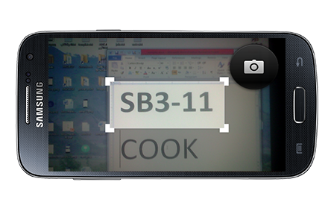
We have used OCR Android library to read class names

Slide 17
Training data for OCR
A data file is required for every language you want to recognize. For English,
This data file is included in the application assets and is automatically installed when the app is first run.

Slide 18
How Tesseract works
The first step is a connected component analysis in which outlines of the components are stored.
This is a computationally expensive design decision at the time, but has a significant advantage
By inspection of the nesting of outlines, and the number of child and grandchild outlines, it is simple to detect inverse text and recognize it as easily as black-on-white text.

Slide 19
Software requirement
Android version 2.2 and Higher version
Standard Development Kit(SDK)
Android Studio ,JDK
internet
CAMERA
MEMMORY_ACSESS
ACCELOROMETER
Some software → Zxing QR code reader

Slide 20
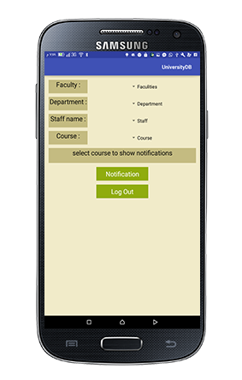
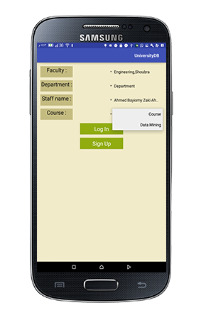
Data base
Local data base in android, this is used in search faculties, departments, staff, courses

Slide 21
Android Web service
There is database needs to be accessed by users via internet Like: login, upload files, notification, so this data base needs to be connected with server
Server receives data from android to store it in
SQL server or to verify if this data is correct or not from SQL server database then return response to the client
Alive server is the server of university but we do not use it. and for testing we used tomcat server that is connected to SQL server

Slide 22
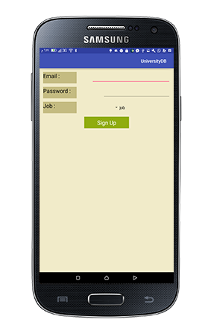
Sign Up

Slide 23
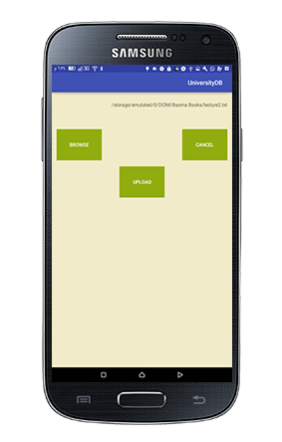
Doctor home page – upload data

Slide 24
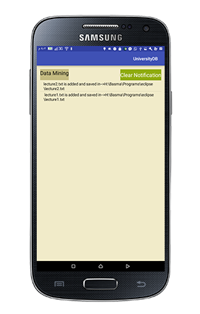
Notifications
on the other hand student can get the notification of particular course

Slide 25
Maps
Each university has many colleges and each college has many buildings,
We worked to help students reach their destination
building easily by GPS, Google maps and so on

Slide 26
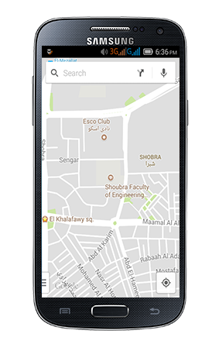
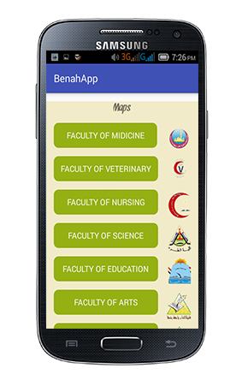
Maps
Google Map navigation to help student reach his destination
list of all colleges to help student choose college he wants to reach
On clicking on any college name it will navigate to its location on Google maps

Slide 27
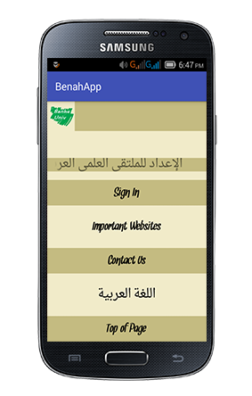
News time line
We also added news timeline to get more interactions from users of App

Slide 28
Calendar
We have added student planner calendar to help student keep up with new events and updates in his college
It needs to synchronize with the server of University to get new updates periodically

Slide 29
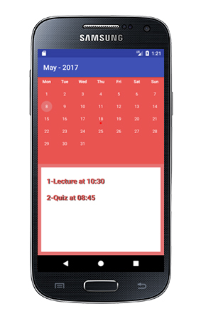
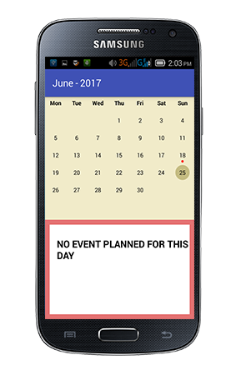
Calendar
See days with events
See days without events i

Slide 30
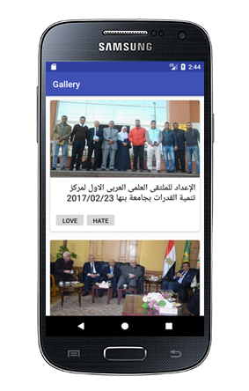
News
One of the advantages of android apps
over websites is that they're closer to the user.
Benha University has a news and photos gallery but not many students are aware of this fact,
So the purpose of this module is to bring the gallery closer to the student.

Slide 31
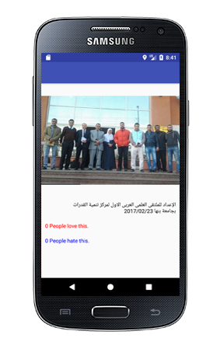
Detailed news event

Slide 32
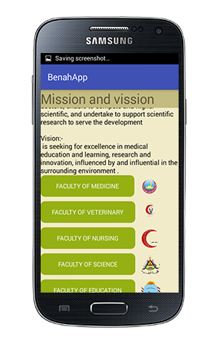
Mission & Vision
Propagate Mission & Vision of Benha university and all of its colleges

Slide 33
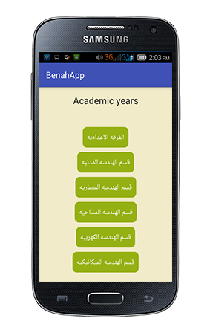
Courses
Easy access and search for any course in the university to know its content and information

Slide 34
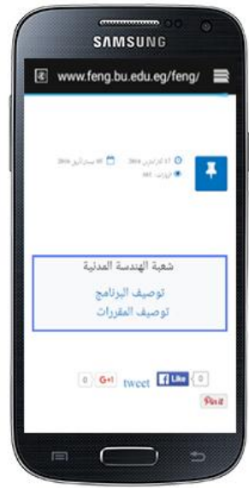
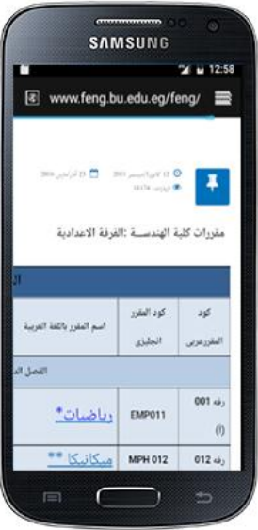
Course description – on website

Slide 35
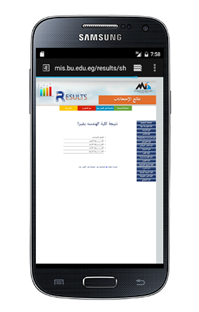
Exam results
we can lead student to the results website to get their exam results

Slide 36
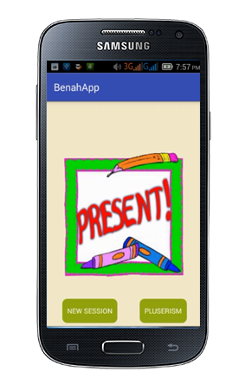
Attendance
It’s one of our best modules
Simply you can use it to record
all students attendance

Slide 37
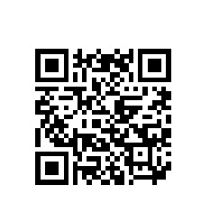
QR codes
Quick Response Code
Started in Japanese automotive industry
QR Codes are 2-dimensional, which results in them having a square filled with data. Besides data, there are certain identifiers helping the code being read correctly

Slide 38
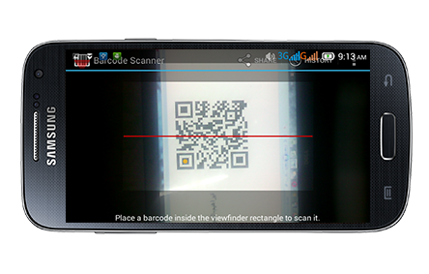
Attendance
We use external QR code ZXING based on tesseract
recorder App to read QR codes

Slide 39
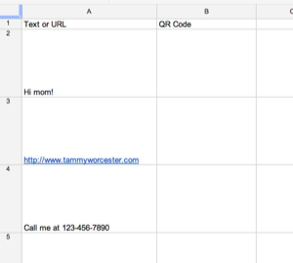
Attendance
We have used Google spread sheet to create bulk QR codes

Slide 40
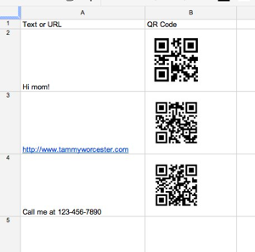
Google spread sheet bulk QR code generator

Slide 41
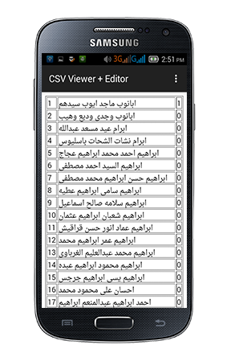
Attendance
You can save attendance local or upload it on drive
you can read your attendance with any csv reader

Slide 42
Motion detection - accelerometer
An accelerometer is an electromechanical device that will measure acceleration forces. These forces may be static, like the constant force of gravity pulling at your feet

Slide 43
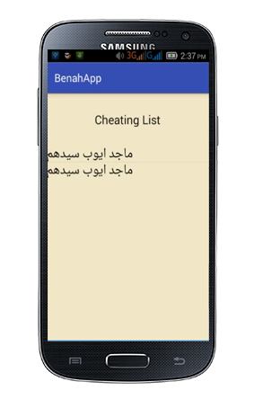
Cheating detection

Slide 44
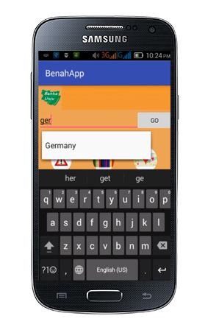
Auto complete TextView

Slide 45
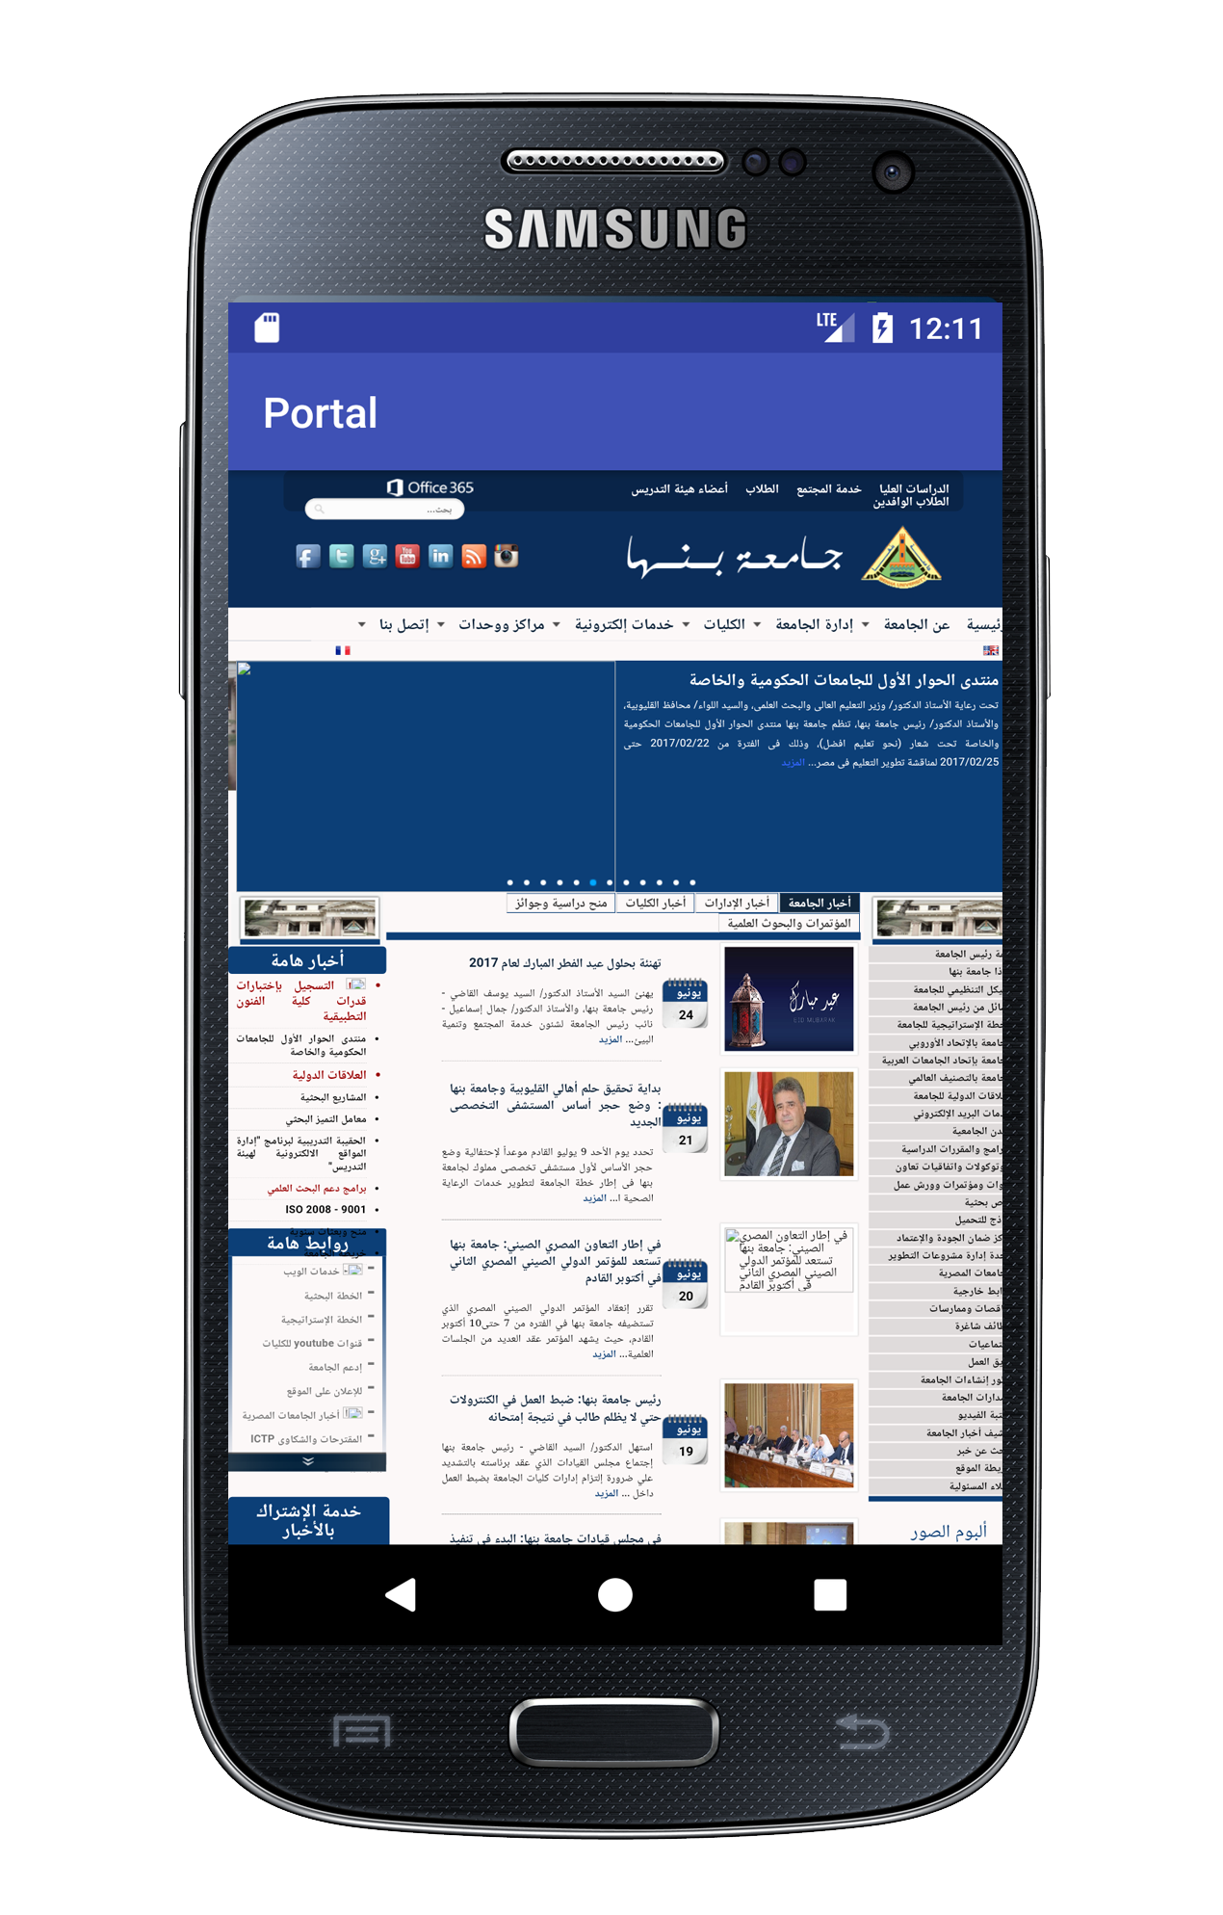
Portal
Allowing easy access to university portal gives our App extra power
It can help check additional features

Slide 46
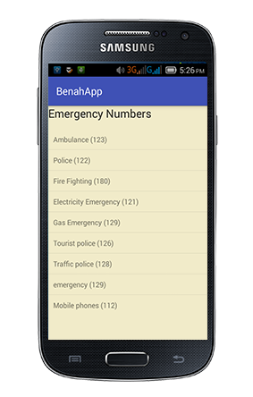
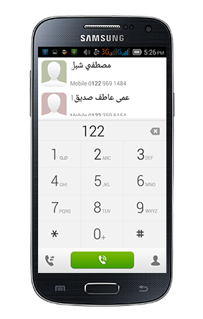
Emergency calls

Slide 47
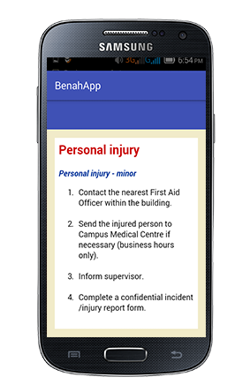
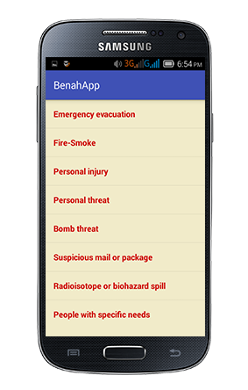
Safety rules

Slide 48
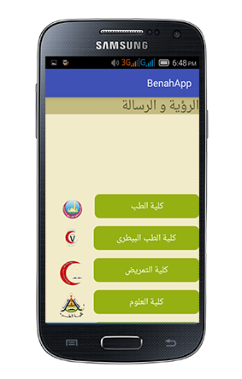
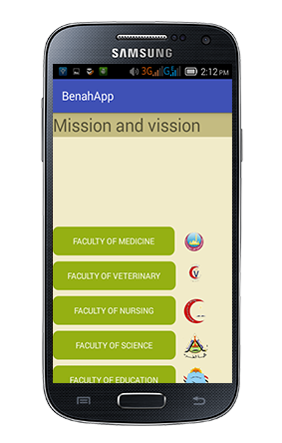
Multi-lingual Arabic-English App
Using smart xml files for multi-lingual app doesn’t need big changes in the App code

Slide 49
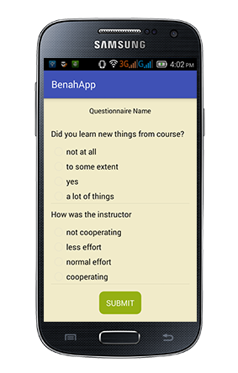
Questionnaire
Questionnaire is very important to develop educational level and college labs
Develop this part from app by answer some question about college staff and the college facilities
Help student and officials to discuss problems and solve it by participation

Slide 50
Important educational websites and settings
To make our App a successful one we needed to make it All in one so any student can get all data he needs from it and can reach any educational resource fast

Slide 51

EKB

Slide 52
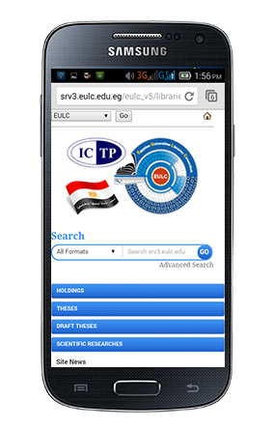
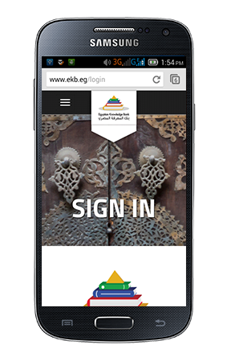
EKB and Egyptian libraries website
logo of EKB on App
logo of ICTP on App

Slide 53
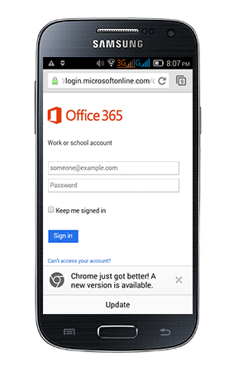
Office365
Easy access and integration with educational mail

Slide 54
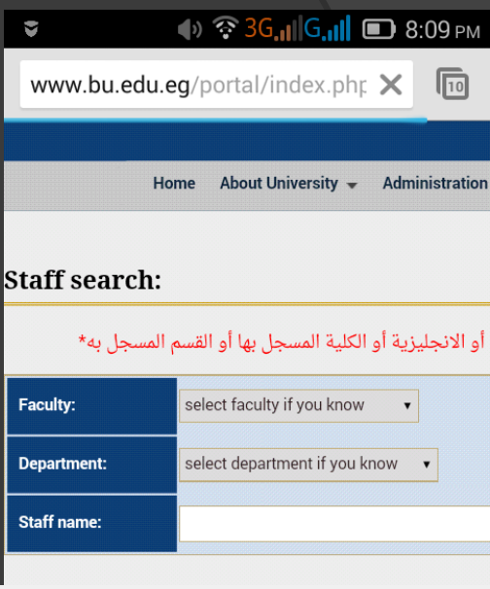
Staff search
Easy access and search for all staff members data

Slide 55
Setting list

Slide 56
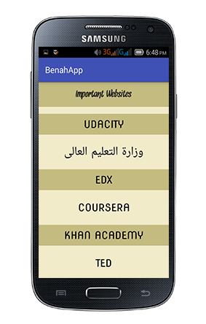
Important websites and MIS contacts

Slide 57
Dimensions and style
Smart ways to add different dimensions for different devices using different xml files
Easy to change all with the least needed code

Slide 58
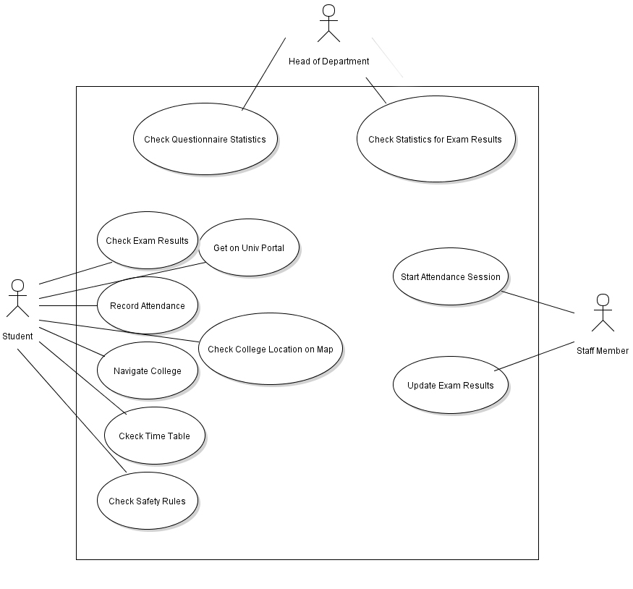
Benha App UML model

